Slide 1
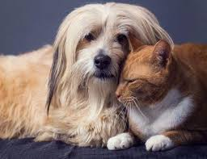
Liver dysfunction
& oxidative balance in dogs and cats

Slide 2
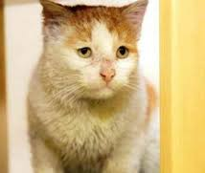
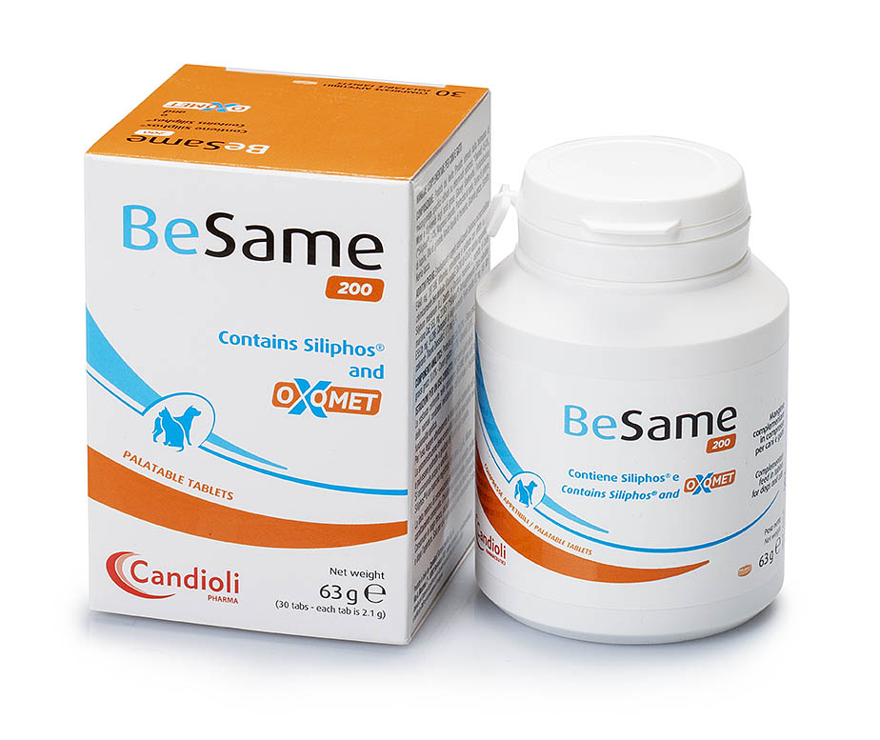
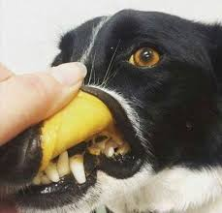
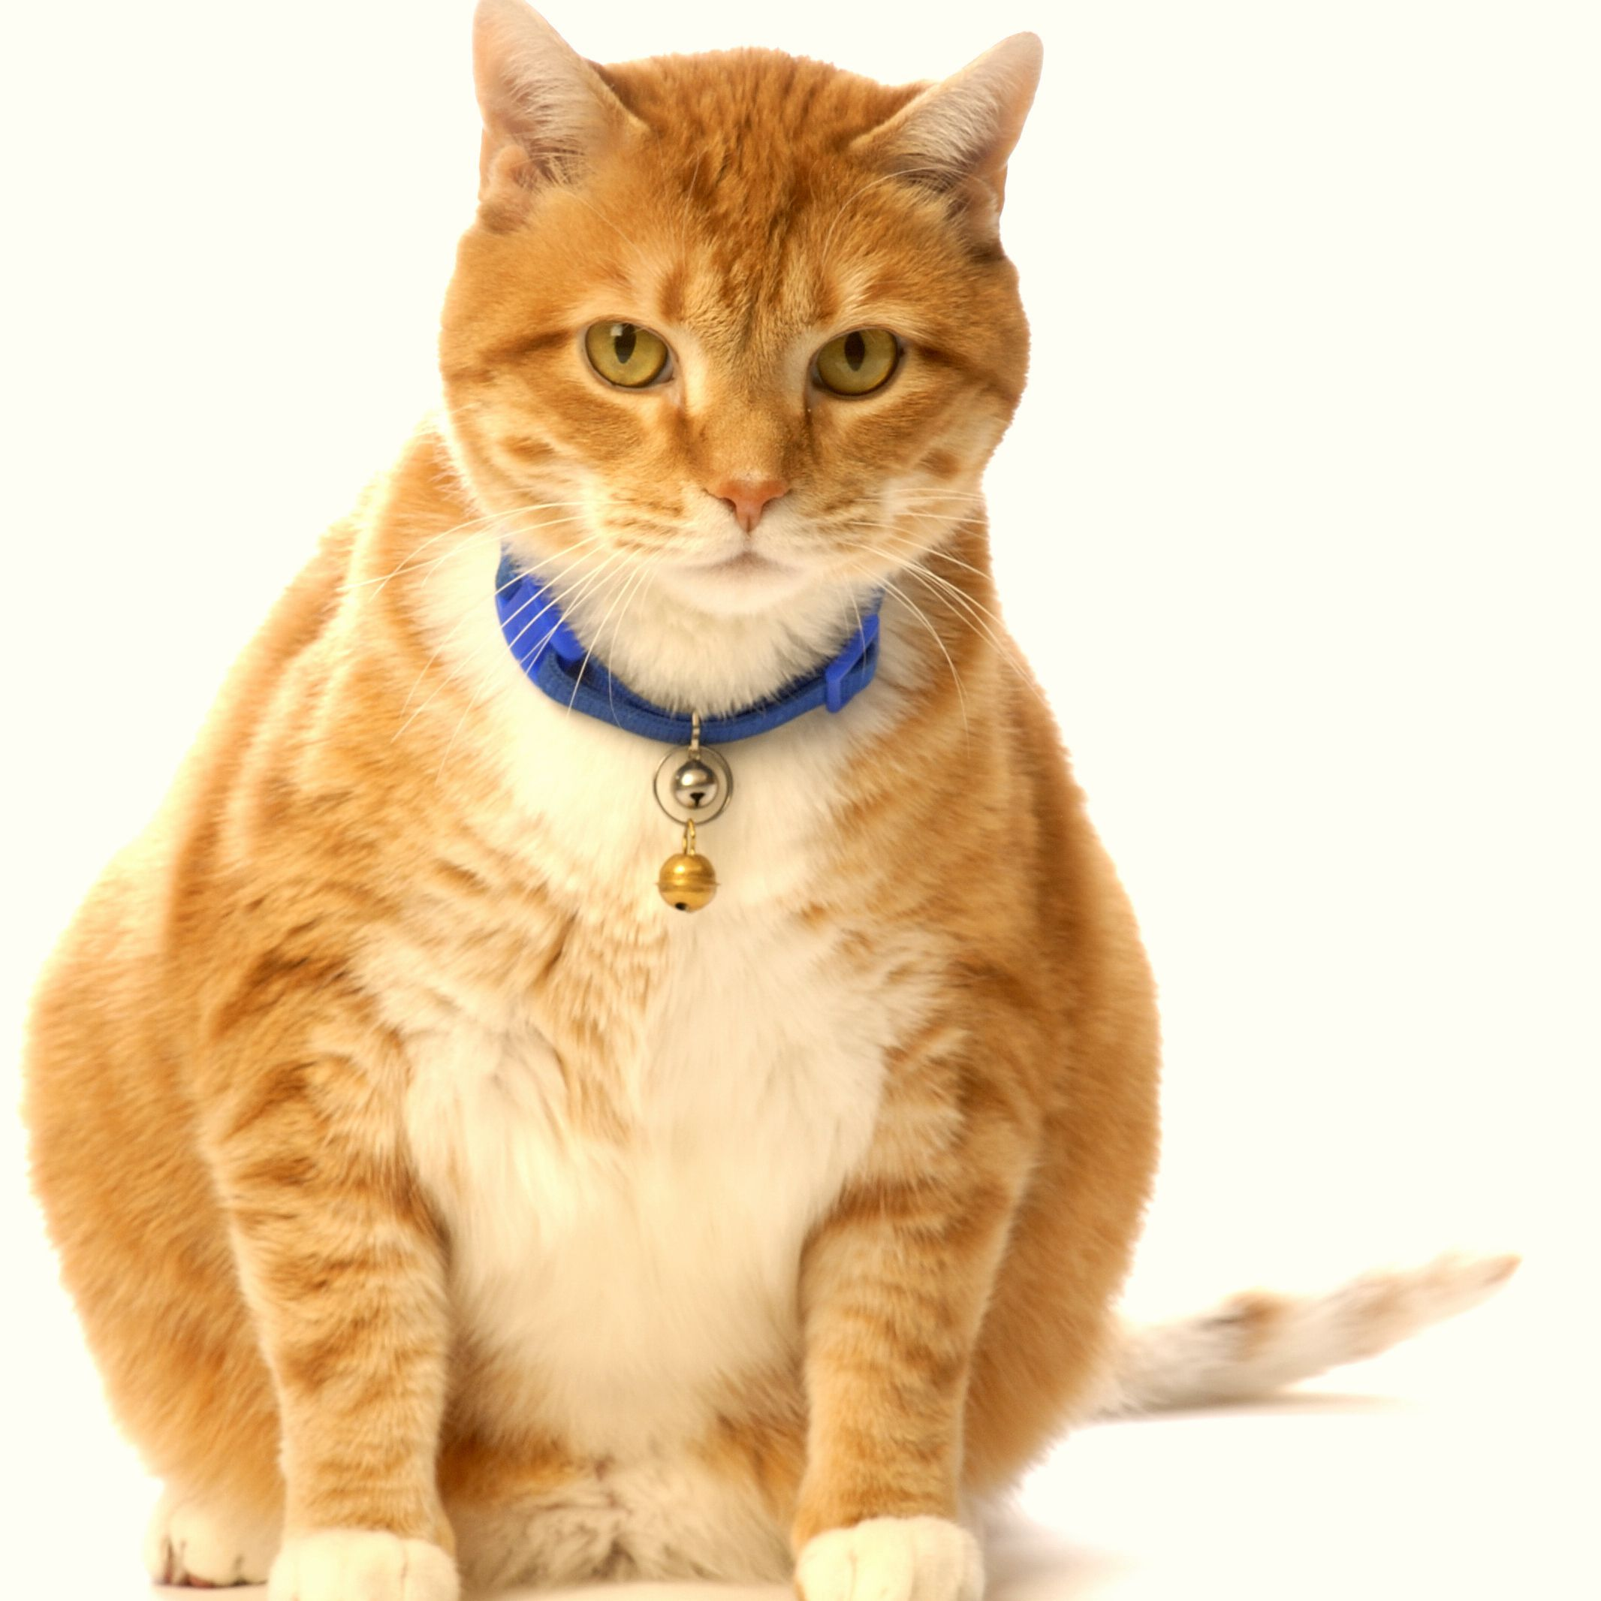
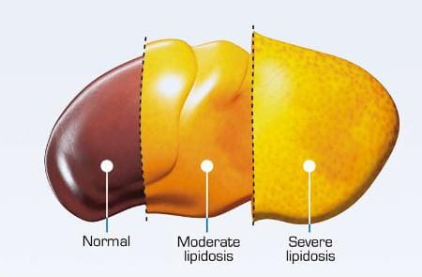
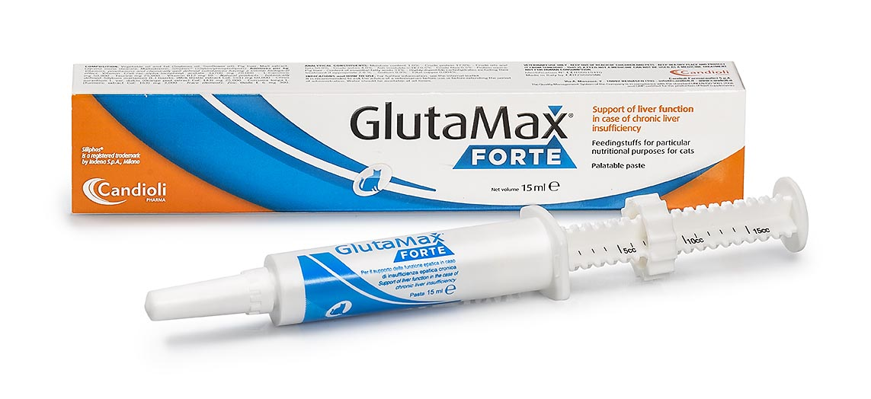
Epidemiology
The most common hepatobiliary diseases:
in dogs are chronic hepatitis
in cats cholangitis and hepatic lipidosis
In USA, hepatic lipidosis is considered the major disease but in Europe cholangitis/cholagiohepatitis is believed to be more common.
Reserved material – internal use only

Slide 3
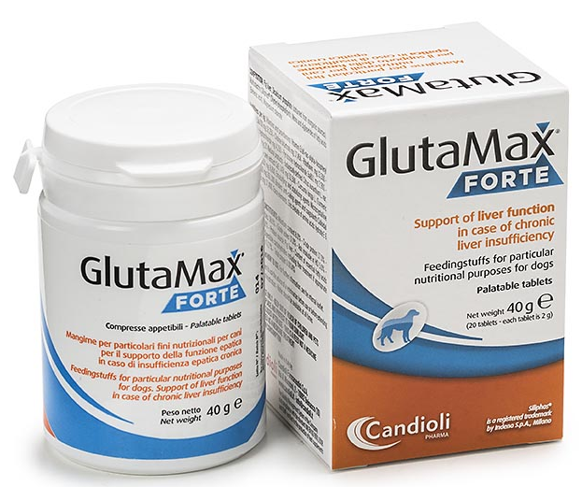
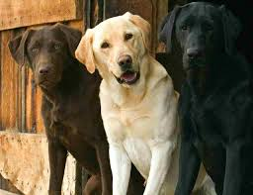
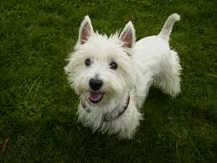
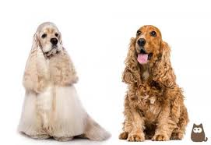
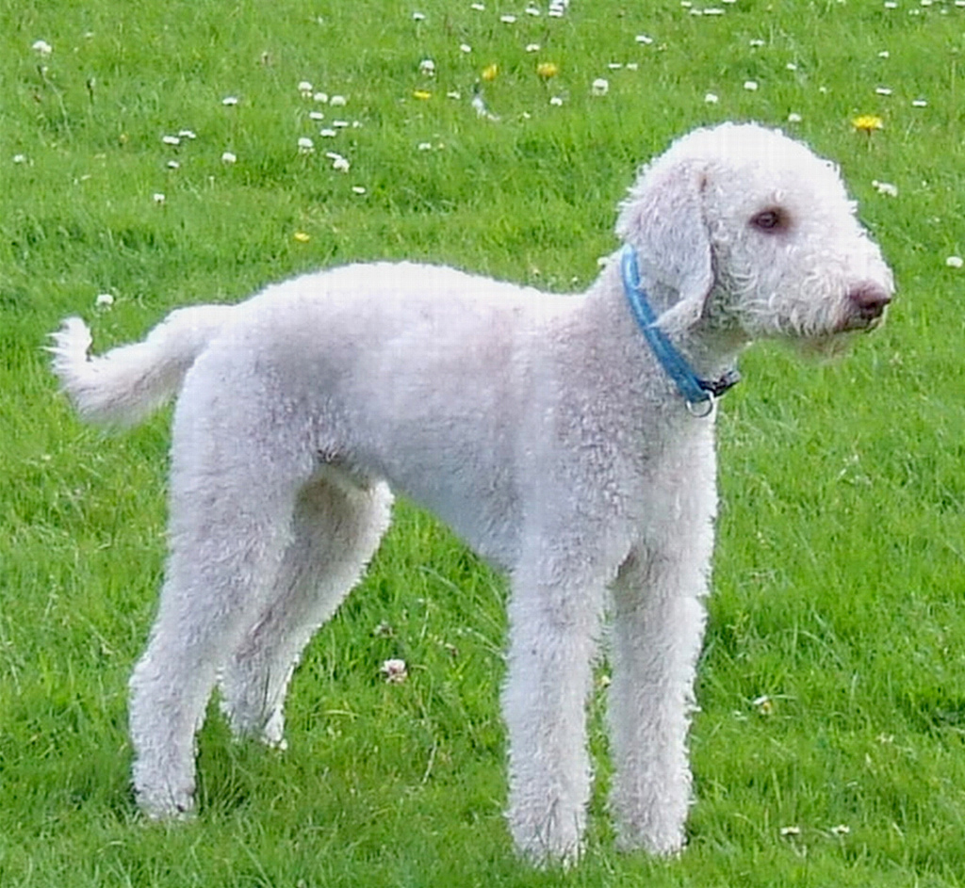
Epidemiology - Dogs
There are breeds susceptible to liver disease as:
Bedlington terrier (predisposed to primary hepatic copper accumulation recognised genetically)
Several dog breeds as Dalmatians, Labrador, WHWT, Skye terrier, Dobermans, English and American cocker spaniels, English springer spaniels can have copper accumulation, familial tendency in developing idiopathic chronic hepatitis or other liver disease as congenital portosystemic shunts.
Small-breed dogs have high prevalence of extrahepatic PSS while intrahepatic PSS tend to be found in dogs of large breeds.
Reserved material – internal use only

Slide 4
Main liver dysfunctions
Vacuolar hepatopathies: a common secondary liver disease in dogs often due to glycogen accumulation usually glucocorticoid-induced (Hyperadrenocorticism or long glucocorticoid treatment)
Chronic hepatitis is very common in dogs belonging to predisposed breeds and rare in cats. It can be due to copper accumulation or vascular abnormalities as portosystemic vascular anomalies or idiopathic.
Cholangitis very common in cats, inflammation of the biliary tract sometimes extends to cholangiohepatitis affecting also the liver. The disease may be acute neutrophilic or chronic lymphocytic. The most usual cause is bacterial infection ascending from the intestine.
Hepatic lipidosis, very common in cats, rare in dogs, is considered the most common hepatic disease in USA (primary and secondary). It is caused by mobilization of peripheral fat due to prolonged anorexia. It happens very often in obese cats.
Neoplasia: primary tumors are less common than metastases in the liver
Reserved material – internal use only

Slide 5
Multimodal approach
Current scientific opinions says:
“Multimodal approach of liver diseases is the best way to reach the best results”
The liver has an amazing array of functions, many of which are disrupted during liver dysfunctions, explaining many clinical signs seen. For this reason it is important to have a multimodal approach, giving the best possibilities to all functions to be recovered and supported.
“Oxidative damage plays a key role in reactive hepatic diseases”
The underlying mechanism of liver damage often involves oxidative and nitrosative stress which results in decreased production of antioxidants as glutathione by the liver
Reserved material – internal use only

Slide 6
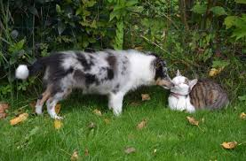
Hepatitis
Chemicals
Drugs
Viral infection
Mycotoxins
Chemicals
Toxins
Viral infection
Copper toxicosis
30% progresses to
ACUTE
CHRONIC
Silymarin
SAMe
Antioxidants
Symptomatics
No clinical signs in the early phases
Silymarin
SAMe
Antioxidants
Zinc
Corticosteroids
Recovered with return to healthy liver
Inflammation
Fibrosis
Cirrhosis
Reserved material – internal use only

Slide 7
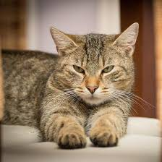
Cholangitis – Cholangio-hepatitis
Young; middle-aged cats
Middle-aged; older cats
Neutrophilic
Lymphocytic
ACUTE
CHRONIC
ACUTE
CHRONIC
Broad-spectrum antibiotic
SAMe
Vitamin E
Vitamin B group
Ursodeoxycholic acid
Broad-spectrum antibiotic
SAMe
Vitamin E
Vitamin B group
Immunomodulators/Glucocorticoids
Reserved material – internal use only

Slide 8
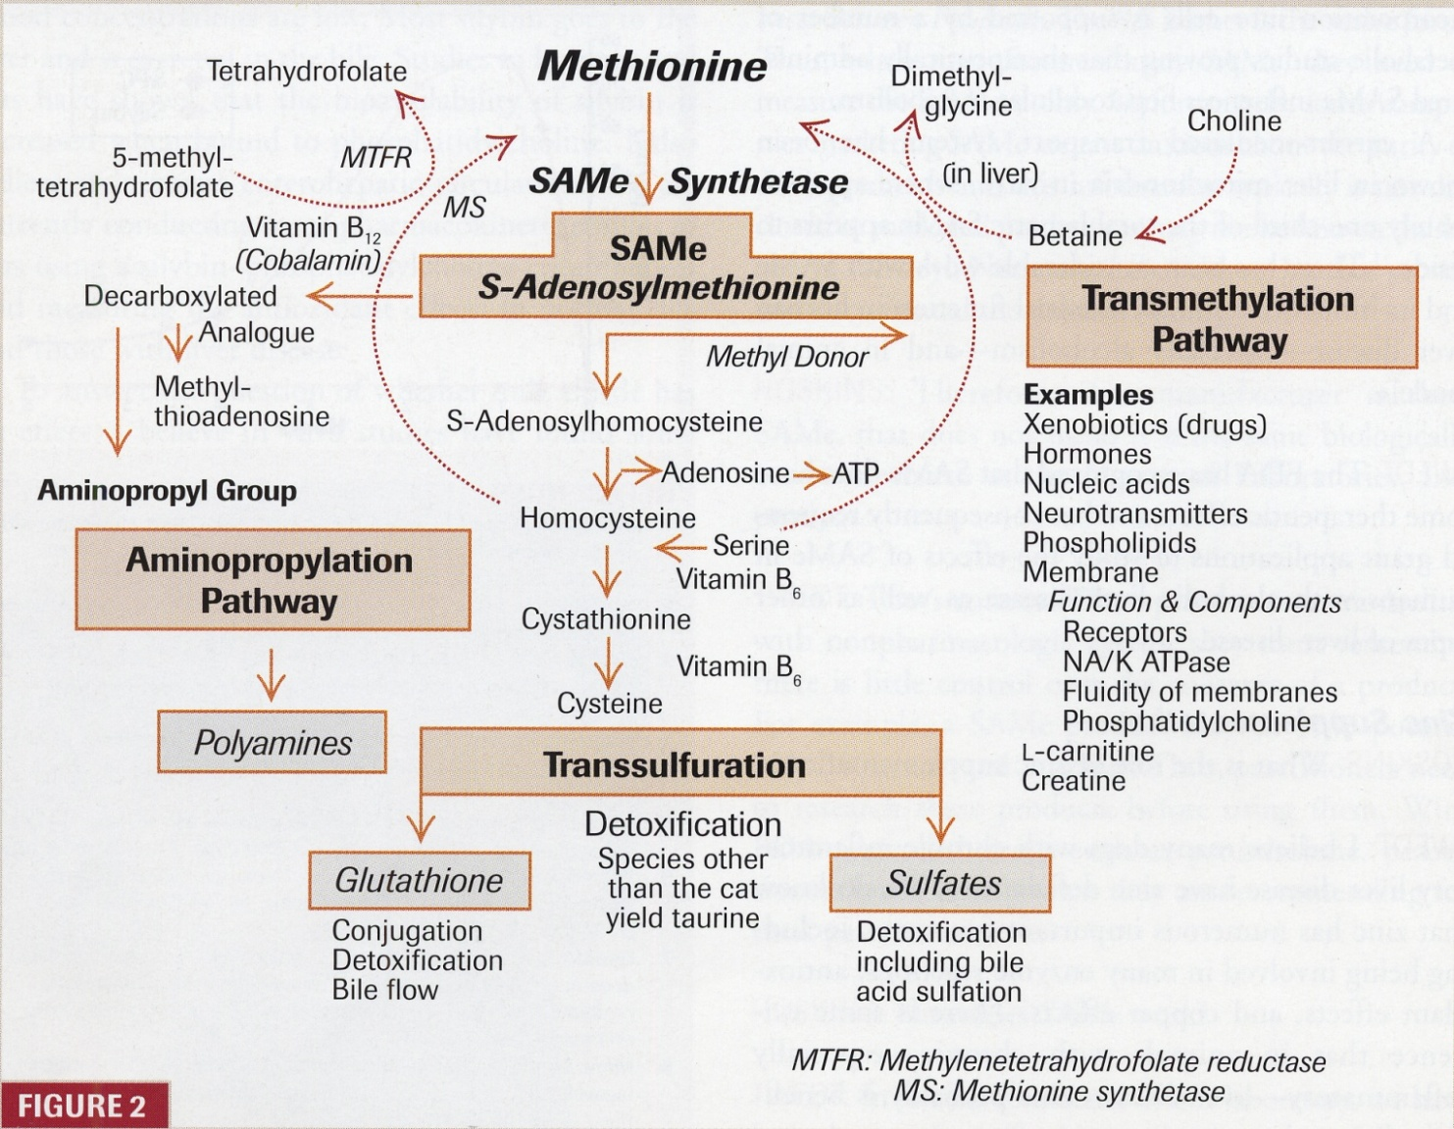
Main liver detoxification pathways
Reserved material – internal use only

Slide 9





How is possible to support the liver?
Curcuma longa
Bioflavonoids (orange)
Zinc (chelated with aminoacids)
Vitamin B₁₂
Vitamin E
Choline
Vitamin B₁, B₂, B₆
Taurine
Carnitine
Reserved material – internal use only

Slide 10
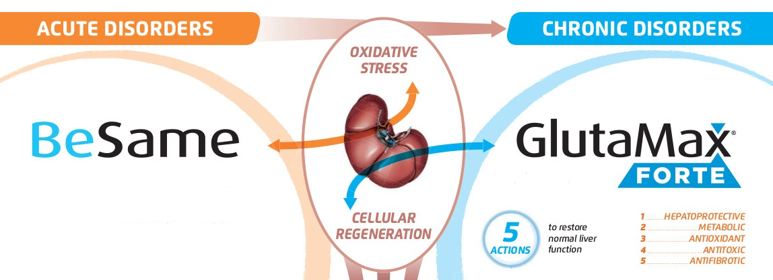
How can be treated acute and chronic liver dysfunction?
Powerful antioxidants
against oxidative damage
Multimodal approach
in 1 product
Reserved material – internal use only

Slide 11
OXOMET is a blend of powerful antioxidants obtained from Saccharomyces cerevisiae dried yeast cell by-product, adding methionine to the fermentation process.
OXOMET has high nutritional value because it is rich in B-group vitamins, proteins and free amino acids that ensure a better liver support
Reserved material – internal use only

Slide 12
GLUTATHIONE is consider as an indispensable component for maintaining a healthy condition of the cell. GLUTATHIONE has a key role in:
Metabolic and cell-cycle related functions
Liver protection
Detoxification
Excretion of drugs and xenobiotics
Anti-aging action
Antioxidant protection against:
Oxidative insults (free radicals, hydrogen peroxide, lipid peroxide)
Damage from toxic compounds
Reserved material – internal use only

Slide 13
SAMe (S-Adenosylmethionine) is a nucleotide-like molecule that initiates 3 mayor biochemical pathways. It has particular importance in hepatocytes which influence the bulk of intermediary metabolism.
SAMe is important for its:
role in metabolism
modulatory influence in inflammation
promotion of cell replication and protein synthesis
cytoprotective effects
importance in promoting sulfation and methylation reaction
role as a precursor of essential intracellular antioxidants (Glutathione)
Reserved material – internal use only

Slide 14
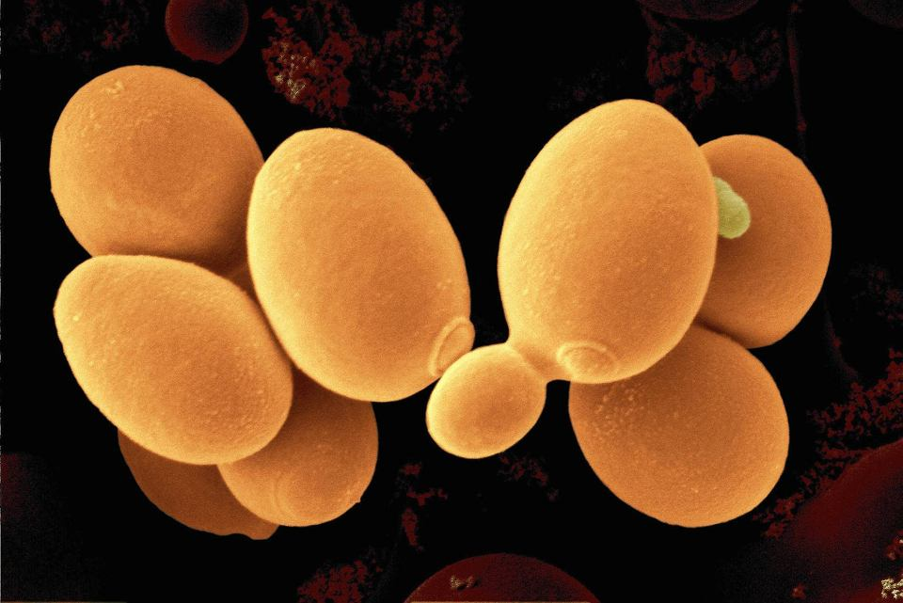
SAMe (S-Adenosylmethionine) is characterized by 2 stereoisomers, S,S-SAMe and R,S-SAMe. Only the S,S-SAMe isomer has preferential high reactivity with liver enzyme (Methyltransferases) while R,S-SAMe isomer may competitively inhibit liver enzymes (Methyltransferases).
The specific production process of OXOMET ensures minimum 75% S,S-SAMe’s concentration
Reserved material – internal use only

Slide 15
Polyamines bind to macromolecules such as DNA, RNA and proteins.
They are involved in different processes:
regulation of gene expression
translation
cell proliferation
modulation of signalling
membrane stabilization
They also modulate the activities of certain sets of ion channels.
Reserved material – internal use only

Slide 16
Main liver detoxification pathways
Reserved material – internal use only

Slide 17
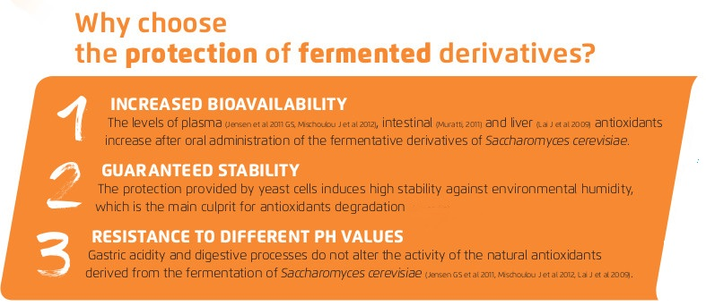
Reserved material – internal use only

Slide 18
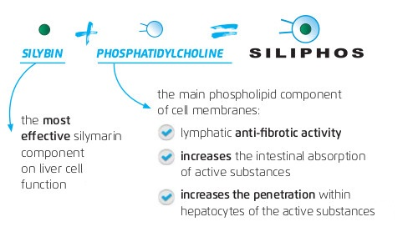
Reserved material – internal use only

Slide 19

Direct antioxidant as free radical scavenger
Indirect antioxidant stimulating glutathione production
Promotes protein synthesis stimulating cell replication and exerting antifibrotic activity
Anti-inflammatory activity inhibiting leukotrienes synthesis
Choleretic and cholagogue
Inhibits hepatotoxins adhesion
Decreases transaminase levels (ALT, AST) and improves prothrombin time
Synergistic effect with vitamin E and phosphatidylcholine
Reserved material – internal use only

Slide 20
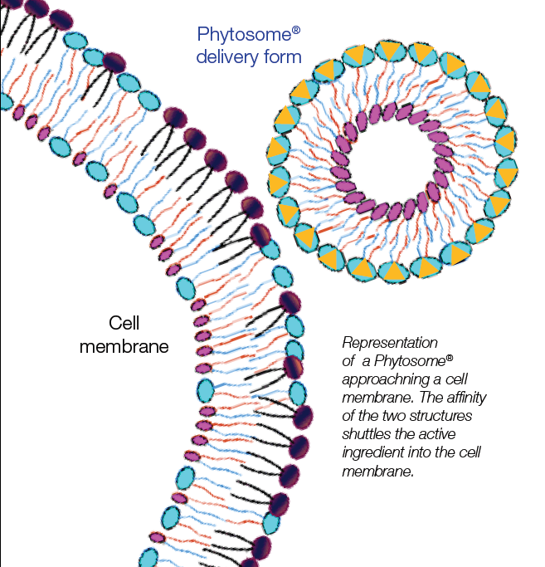
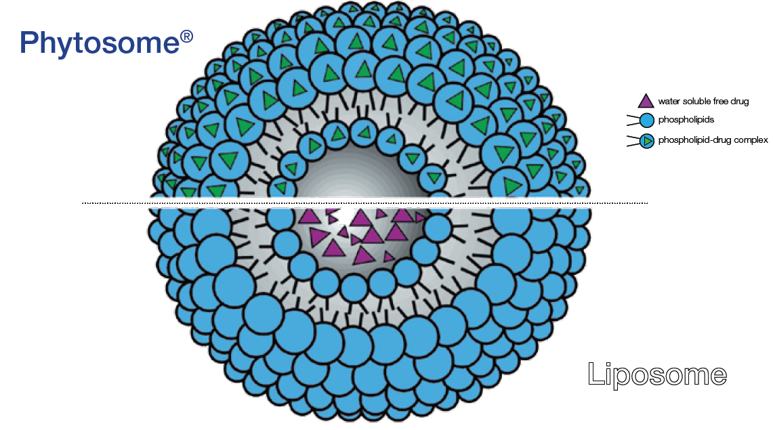
Reserved material – internal use only

Slide 21
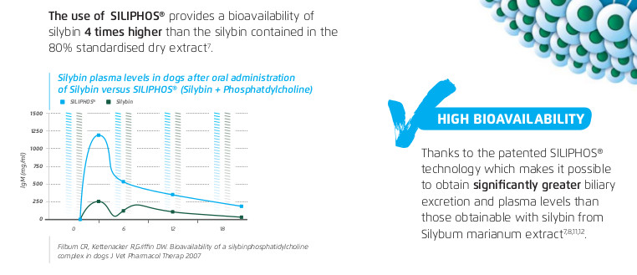
Reserved material – internal use only

Slide 22
Summarizing
SAMe
Antitoxic, Antioxidant & Metabolic activity
Glutathione
Antioxidant Antitoxic & Hepatoprotective activity
Poliamines
Antifibrotic, Antioxidant & Metabolic activity
Silybin
Antioxidant & Anti-inflammatory activity
Phosphatidylcholine
Anti-fibrotic activity
Reserved material – internal use only

Slide 23
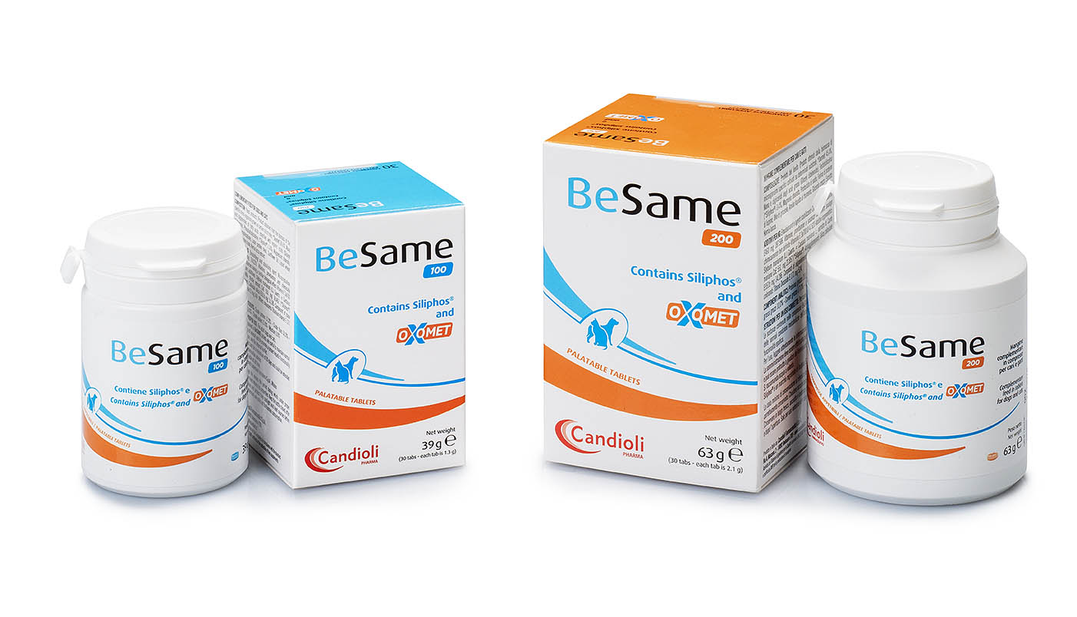
Indications
Liver dysfunctions caused by iron and/or copper accumulation
Inflammatory, toxic and immuno-mediated liver dysfunctions
Cholestasis
Cholangitis and Cholangio-hepatitis
Reserved material – internal use only

Slide 24
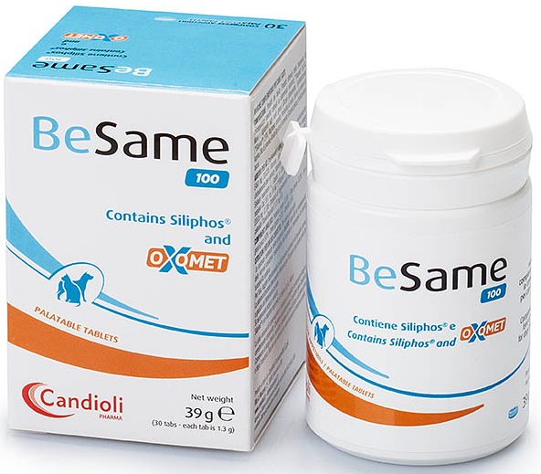
Dosage
BeSame 100 contains 100mg SAMe
1 tablet every 5 kg BW
Administer the tablet crushed or whole as you prefer.
Best bioavailability 1 h before the main meal
BeSame 200 contains 200mg SAMe
1 tablet every 10 kg BW
Administer the tablet crushed or whole as you prefer.
Best bioavailability 1 h before the main meal
Reserved material – internal use only

Slide 25


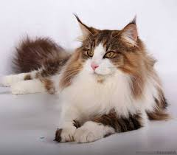
Lipidosis
Cholangitis
Chronic hepatitis
Dog formula
Cat formula
Reserved material – internal use only

Slide 26
Dog formula
composition
Chronic hepatitis
Siliphos
Curcuma longa
Bioflavonoids (orange)
Zinc (chelated with aminoacids)
Vitamin B₁₂
Vitamin E
Choline
Vitamin B₁, B₂, B₆
Reserved material – internal use only

Slide 27
Cat formula
composition
Lipidosis
Cholangitis
Siliphos
Curcuma longa
Bioflavonoids (orange)
Zinc (chelated with aminoacids)
Vitamin B₁₂
Vitamin E
Taurine
L-carnitine
Reserved material – internal use only

Slide 28
Direct antioxidant as free radical scavenger
Indirect antioxidant stimulating glutathione production
Promotes protein synthesis stimulating cell replication and exerting antifibrotic activity
Anti-inflammatory activity inhibiting leukotrienes synthesis
Choleretic and cholagogue
Inhibits hepatotoxins adhesion
Decreases transaminase levels (ALT, AST) and improves prothrombin time
Synergistic effect with vitamin E and phosphatidylcholine
Reserved material – internal use only

Slide 29
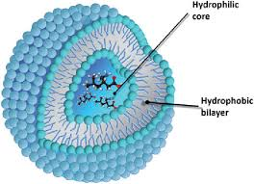
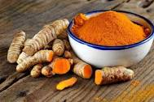
Curcuma longa
Herb used in traditional Chinese and Ayurvedic medicine, very well known for its healthy properties. The main obstacle to its effectiveness is the relatively low bioavailability of curcumin dry extract due to its instability, poor solubility and absorption.
Glutamax Forte contains a phytosomised form of Curcumin similar to Siliphos that increases more than 20 times curcumin bioavailability.
Reserved material – internal use only

Slide 30
Curcuma longa
Curcumin exerts remarkable protective and therapeutic effects of oxidative associated liver diseases suppressing:
proinflammatory cytokines
lipid peroxidation products
hepatic stellate cells activation
Curcumin is considered a very strong lipid-soluble antioxidant.
It acts as free radical scavenger, neutralizes ROS and RNS.
Curcumin exerts choleretic and cholagogue effect improving bile excretion and fluidity.
Reserved material – internal use only

Slide 31
Bioflavonoids from C. aurantium
Quercetin
Antioxidant flavonoid with anti-inflammatory activity by inhibiting pro-inflammatory cytokines and histamine release.
Hesperidin
Flavonoid with anti-inflammatory, antioxidant, antiallergic and antidiabetic effects.
increases antioxidant enzymes as SOD and Glutathione (GSH)
Inhibits inflammatory cytokines (TNF-α and IL-1β)
reduces ROS
inhibits histamine release from Mast cells
Rutin
a quercetin’s glycoside with anti-inflammatory effects inhibiting oxidative stress and TNF-α and IL-1β
Reserved material – internal use only

Slide 32
Vitamin E
Powerful antioxidant, protects against oxidative damage induced by bile acids
Protects from free radicals, helpful in inflammatory liver dysfunctions
Antioxidant activity enhanced by simultaneous administration of Bioflavonoids, Zinc, Ascorbic acid (vitamin C) and thiols (as SAMe).
Low intrahepatic level during liver dysfunction and metal intoxication.
Reserved material – internal use only

Slide 33
Zinc
Zinc in Glutamax Forte is mainly chelated with amino acids (Glycine) to avoid collateral effects on GI tract
Inhibits collagen synthesis and decreases hepatic fibrosis
Antioxidant effect as a cofactor of SOD (superoxide dismutase)
Impairs copper absorption inside hepatic cells (useful in copper intoxication)
Antioxidant activity enhanced by vitamin E
Cofactor of many enzymes during chronic liver dysfunction its deficiency is common and causes a decrease in ammonia detoxification
Reserved material – internal use only

Slide 34
Vitamin B₁₂
Vitamin B₁₂ is the only water soluble vitamin that can be stored in the liver also for years.
It is a cofactor in liver metabolism pathways, so its amount is critical in chronic liver dysfunctions due to the fact that is involved in glutathione reduction.
Reserved material – internal use only

Slide 35
Main liver detoxification pathways
Reserved material – internal use only

Slide 36
Vitamin B_{1,}B_{2,}B₆ and Choline
Vitamin B₆ is involved in glutathione reduction.
Vitamin B₂ indirectly increases reduced form of glutathione as part of glutathione redox cycle.
Vitamin B₁ is important as coenzyme in energy metabolism.
Choline in involved in detoxification metabolic pathways favouring the formation of non-toxic intermediate metabolites (SAMe pathway)
Reserved material – internal use only

Slide 37
Taurine and L-Carnitine
Taurine is an essential amino acid in cats. It is involved in:
Bile acid conjugation
Xenobiotics detoxification
Intra- and extra-cellular calcium metabolism
inhibition of the translocation of intestinal endotoxins
Recommended in case of lipidosis and liver cholestasis
L-Carnitine is a vitamin like water soluble molecule that is concentrated in cardiac and skeletal muscle. It has an important role in fat oxidation and energy generation. Carnitine improves fatty acid oxidation protecting from intrahepatic fat storage.
Reserved material – internal use only

Slide 38
Indications
Support liver functionality in chronic primary or secondary disease in dogs and cats as:
Liver dysfunctions caused by iron and/or copper accumulation
Chronic hepatitis
Hepatotoxic drugs (antifungals, barbiturates, chemotherapeutics)
Poisoning (support after acute treatment)
Cholestasis
Cholangitis
Lipidosis
Reserved material – internal use only

Slide 39
Dosage
DOGS
GlutaMax Forte tabs
1 tablet every 10 kg BW
Initial period of administration 20-40 days
Administer the tablet crushed or whole as you prefer.
CATS
GlutaMax Forte paste
1 ml every 3.5 kg BW
Initial period of administration 20-40 days
Administer the paste directly into the mouth or in the food.
Reserved material – internal use only

Slide 40
Summarizing
Anti-inflammatory activity
Siliphos
Silybin
Antioxidant activity
Phosphatidylcholine
Anti-fibrotic activity
Curcuma longa
choleretic activity and cholagogue
Curcumin
Antioxidant & antitoxic activity
Bioflavonoids
Quercetin
Antioxidant & anti-inflammatory activity
Hesperidin
Vitamin E
Antioxidant & antitoxic activity
Zinc
Antioxidant & antitoxic activity
Metabolic activity
Vitamin B₁₂
Antitoxic & metabolic activity
Reserved material – internal use only

Slide 41
Summarizing
Vitamin B₁ B₂ B₆
Antitoxic & metabolic activity
Choline
Antitoxic & metabolic activity
Taurine
Antitoxic & hepatoprotective activity
L-Carnitine
Antitoxic, Metabolic & Hepatoprotective activity
Reserved material – internal use only

Slide 42
Combined therapy protocol BeSame /GlutaMax forte in case of acute liver diseases
Then continue for 40-60 days of treatment
First 15 days of treatment
Reserved material – internal use only

Slide 43
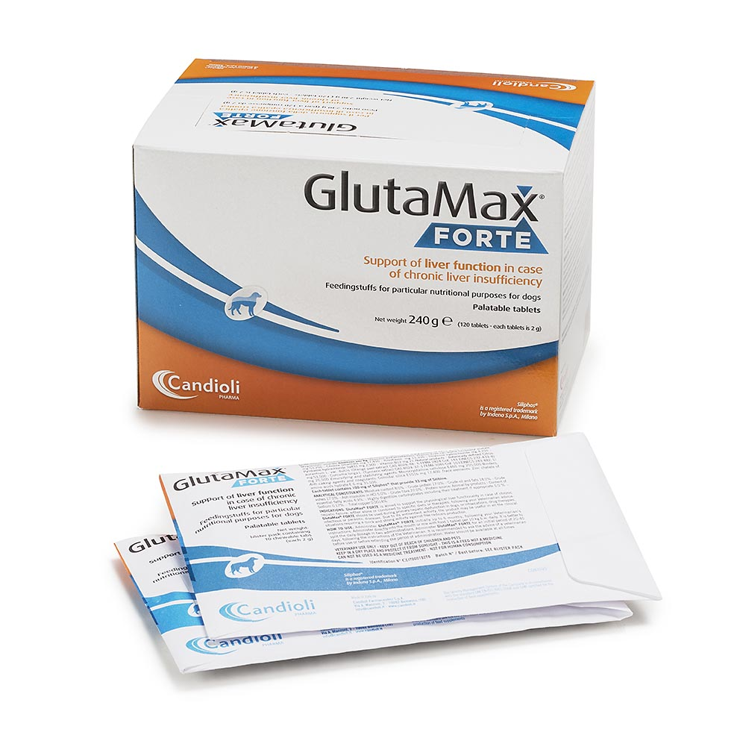
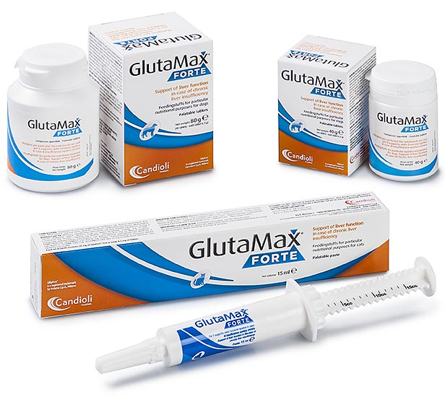
2 is better than 1
to support liver
dysfunctions
Reserved material – internal use only

Slide 44
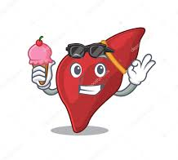
Thanks for your attention
Reserved material – internal use only

